Slide 1
Natural Language Processing
Section One: Overview & Representation

Slide 2
NLP definition
Natural language processing (NLP) is a subfield of computer science and artificial intelligence (AI) that uses machine learning to enable computers to understand and communicate with human language. [1]
Natural language processing (NLP) is the discipline of building machines that can manipulate human language — or data that resembles human language — in the way that it is written, spoken, and organized. [2]

Slide 3
NLP History
1- 1964 ElIZA was created, designed to imitate a psychiatrist using reflection techniques (no computer understanding)
2- 1980s Several complicated statistical models were created, this was led by IBM
3- 1990 N-Grams have become useful, recognizing and tracking clumps of linguistic data, numerically.
4- In 1997, LSTM recurrent neural net (RNN) models were introduced, and found their niche in 2007 for voice and text processing. [3]

Slide 4
String Representation: Machine Representation
String
Character
S | t | r | i | n | g
1001 | 1002 | 1003 | 1004 | 1005 | 1006
Letter | ASCII Code | Binary
a | 097 | 01100001

Slide 5
String Representation: one-hot encoding
Word | Encoding
I | [1,0,0,0,0,0]
love | [0,1,0,0,0,0]
cats | [0,0,1,0,0,0]
not | [0,0,0,1,0,0]
dogs | [0,0,0,0,1,0]
I | [1,0,0,0,0,0]
agree | [0,0,0,0,0,1]
Assume a sentence: - I love cats not dogs
- I agree

Slide 6
String Representation: one-hot encoding cont.
In a dataset for text classification:
f1 | f2 | f3 | f4 | f5 | f6 | f7 | Label | Text Represented
1 | 1 | 0 | 0 | 0 | 0 | 0 | 1 | [I, love]
0 | 1 | 1 | 1 | 1 | 0 | 0 | 0 | [love, cats, not]
1 | 1 | 0 | 0 | 0 | 1 | 0 | 1 | [I, love, I, dogs]
1 | 0 | 0 | 0 | 0 | 0 | 1 | 1 | [I, dogs, agree, agree]

Slide 7
String Representation: Bag of Words
It’s just one-hot encoding but with an extra step. Which is counting how much each word is repeated.
f1 | f2 | f3 | f4 | f5 | f6 | f7 | Label | Text Represented
1 | 1 | 0 | 0 | 0 | 0 | 0 | 1 | [I, love]
0 | 1 | 1 | 1 | 1 | 0 | 0 | 0 | [love, cats, not]
2 | 1 | 0 | 0 | 0 | 1 | 0 | 1 | [I, love, I, dogs]
1 | 0 | 0 | 0 | 0 | 0 | 1 | 2 | [I, dogs, agree, agree]

Slide 8
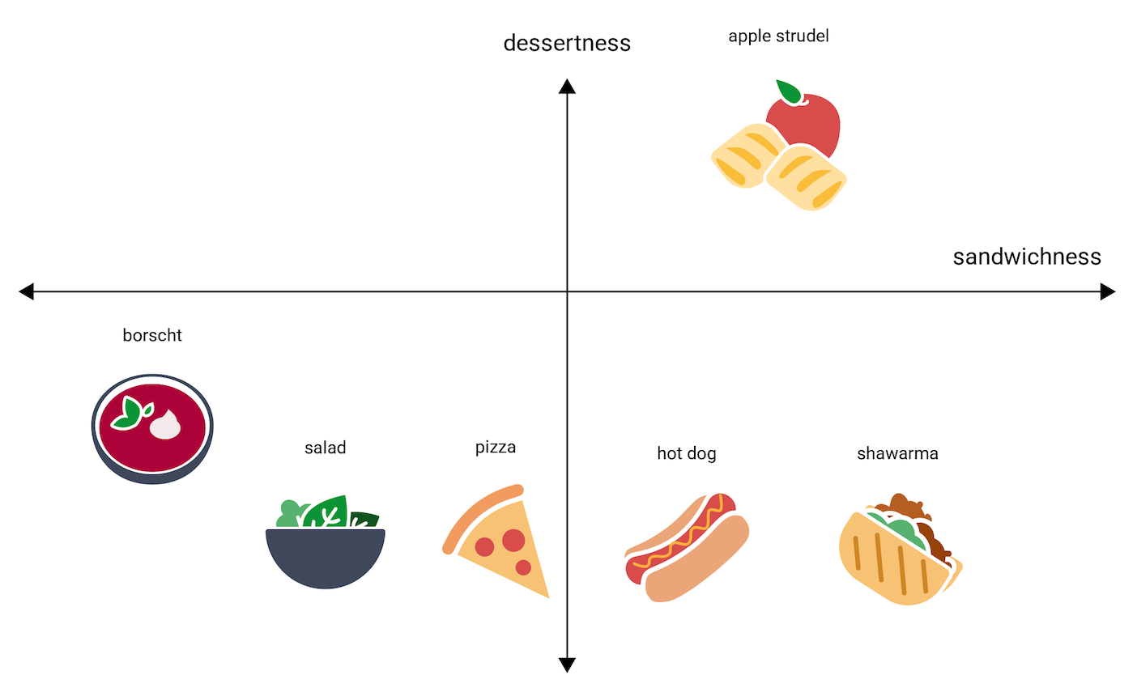
String Representation: Embedding Space
An embedding is a vector representation of data, in our case it’s words/tokens. This representation is reflection of its meaning.
The “meaning” is its relative position of it in the embedding space (vector space of embeddings) to similarly semantic words.

Slide 9
String Representation: Embedding Space
Word | Encoding
I | [0.1, -0.2, 0.4, 0.8, -0.1, 0.3]
love | [0.5, 0.7, -0.3, 1.1, 0.4, -0.2]
cats | [0.8, -0.5, 0.6, 0.3, -0.7, 0.9]
not | [0.2, -0.4, 0.1, 0.5, 0.3, -0.6]
dogs | [0.7, -0.8, 0.2, 0.9, -0.3, 0.6]
I | [0.1, -0.2, 0.4, 0.8, -0.1, 0.3]
agree | [0.6, 0.9, -0.1, 1.3, 0.2, -0.4]
Assume a sentence: - I love cats not dogs
- I agree

Slide 10
String Representation: Embedding Space cont.
In a dataset for text classification:
We represent a sentence by pooling the embedding.
Pooling is summing the vectors then dividing it by the number of vectors.
f1 | f2 | f3 | f4 | f5 | f6 | Label | Text Represented
0.3 | 0.25 | 0.05 | 0.95 | 0.15 | 0.05 | 1 | [I, love]
0.5 | -0.067 | 0.13 | 0.63 | 0 | 0.03 | 0 | [love, cats, not]
0.35 | -0.125 | 0.175 | 0.9 | -0.025 | 0.25 | 1 | [I, love, I, dogs]
0.5 | 0.2 | 0.1 | 1.075 | 0 | 0.025 | 1 | [I, dogs, agree, agree]

Slide 11
Comparing representation methods
Aspect | One-Hot Encoding | Bag of Words | Embedding Vectors
Vector size | Large (vocab size) | Large (vocab size) | Small (50-300 dims)
Semantic understanding | None | None | High
Memory usage | Poor | Poor | Good
Word relationships | No | No | Yes (similar words close)
Training needed | No | No | Yes
Best for | Simple classification | Document classification | Modern NLP tasks

Slide 12
Coding
1- Create one-hot encoding from scratch
2- Create Bag of Words embedding from scratch
3- Use and explore Embedding Space in Word2Vec and Glove
4- Bonus: plotting the vectors representing words after processing them using PCA.

